Slide 1



Slide 2
Highlights
Motivation Behind MSU
What is MSU
Salient features of MSU
How easy to adapt/use MSU
Where we Stand after OTM

Slide 3


Motivation Behind MSU
TeSys-T had a firmware issue because of which 7000 devices had to be re-programmed!
It uses FTP for upgrading devices
Though FTP is reliable it has some disadvantages:-
  Manual interventions ( Identify the IP address of each device and then establish the connection before sending files).
  Even if there are many devices of the same hardware type and they use the same binary file, the procedure is repeated.
  Uses more network resources (wrt Bandwidth)
  Takes long time if there are many devices.

Slide 4

What is MSU
MSU is a protocol with Client- Server Model based on UDP/IP
  MSU Server is hosted on PC
  It has a GUI from which user can choose the file ( Binary, Executable etc) to be sent on the devices who needs an upgrade
MSU Clients is part of the Device Firmware
  MSU client is developed in C and it can be ported on the devices or is also available as a C library

Slide 5
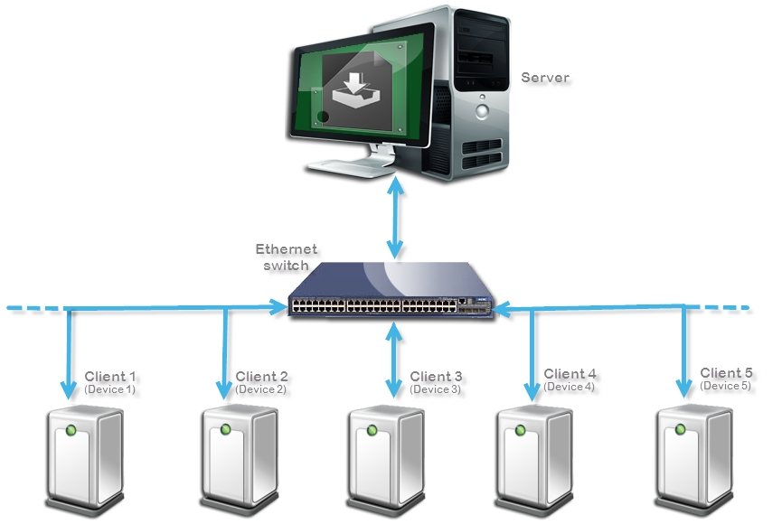
Example of an MSU scenario

Slide 6

Salient feature of MSU
MSU can perform simultaneous file transfer to may devices on the network
Bandwidth consumption will always be equal to 1 device
Time consumption will always be equal to 1 device
MSU creates list of the devices on the network before to start the process
Apply upgrade process on selected group (s)of devices
Multiple groups can be selected simultaneously (different Binaries)
Gives the Status about the devices whether they passed, failed or faulty at the end of upgrade process
Status of file transfer is validated by CRC at the end of file transfer (Optional can be enable/disable by compile time MACRO)

Slide 7

How easy to adapt to MSU Client
MSU Client
  Currently MSU only exploit Ethernet (UDP/IP)
  Future may be on many
  MSU is available as C library (source code also available), which can be easily ported
  Currently MSU support two platform (Linux and IPCL (Freescale) )
  The device should have below requirements to adapt to MSU
    Stack required
      UDP/IP
    Number of UDP sockets required
      2
    RAM
      Stack size : 2KBytes
      Global/Heap : 1KBytes + 1.5KBytes(Ethernet Frame size)
    Flash
      Memory Footprint : 12KB (Core component)

Slide 8
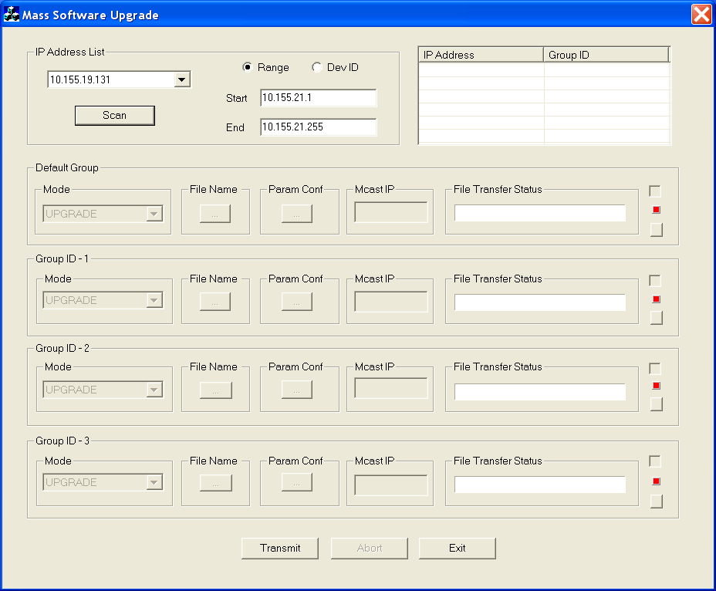
How easy to use MSU Server
MSU server is a standalone PC based application runs on windows XP

Slide 9
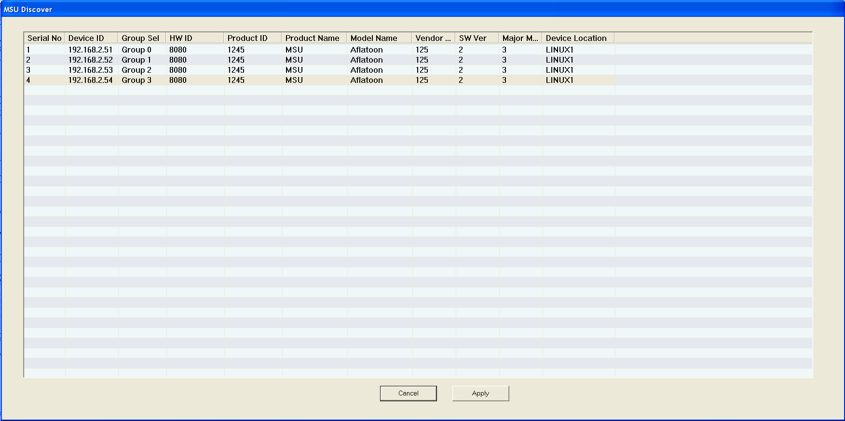
How easy to use MSU server
Discovered devices

Slide 10
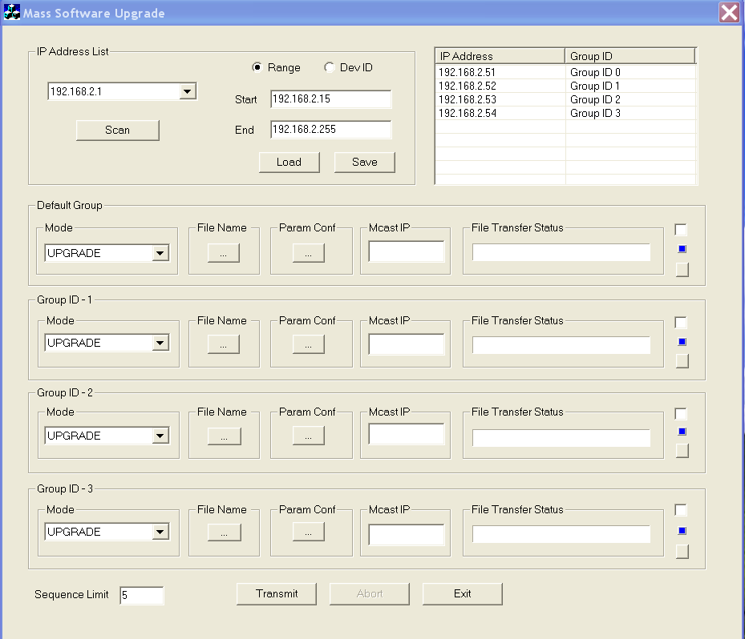
How easy to use MSU server
Group list

Slide 11
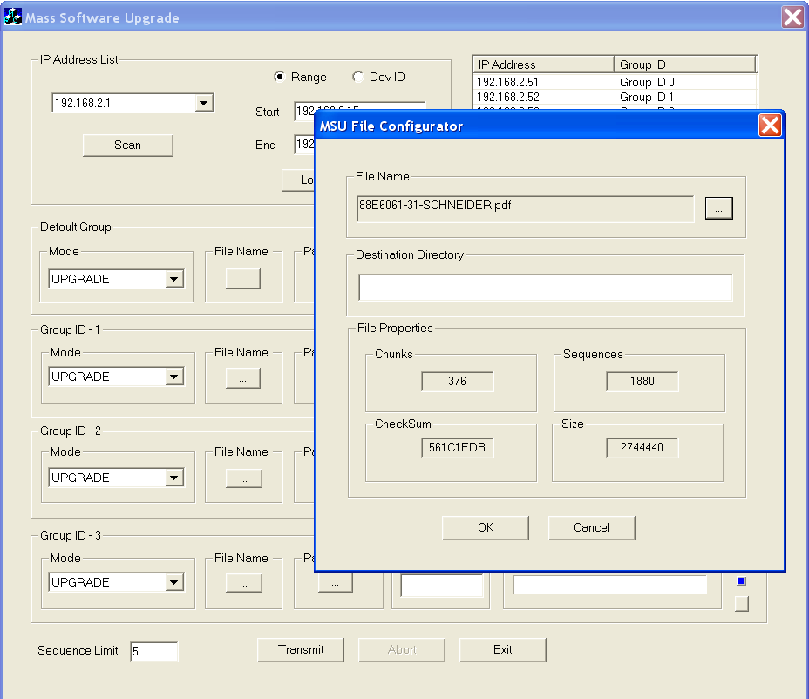
How easy to use MSU server
File selection for different Group

Slide 12
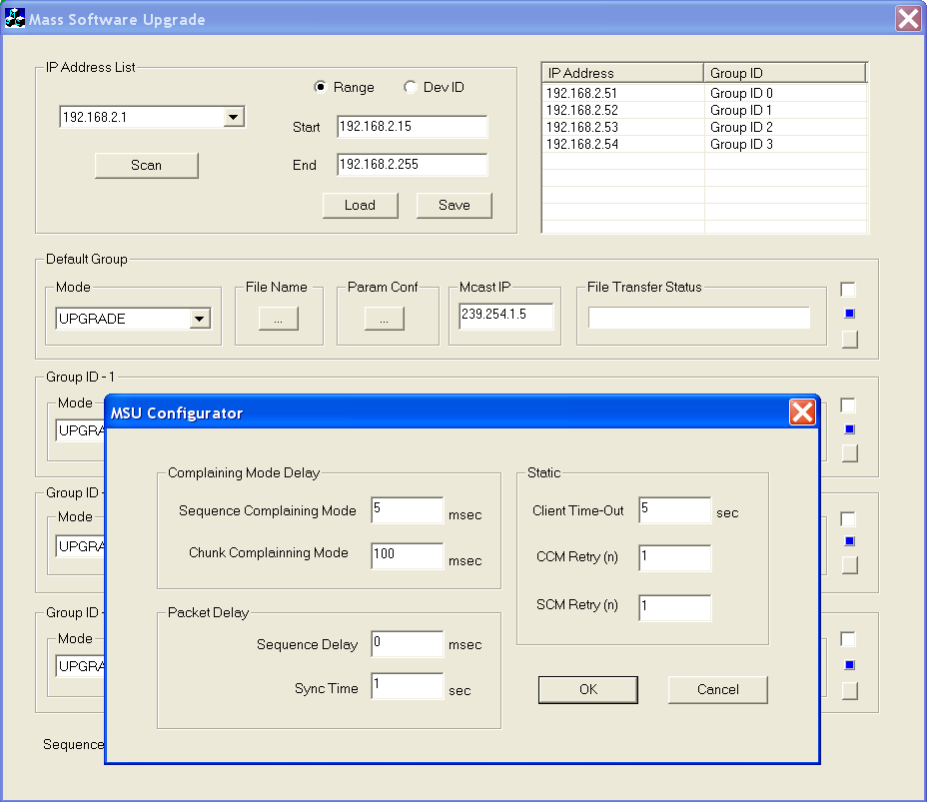
How easy to use MSU server
Communication Parameters selection provided by each Client

Slide 13
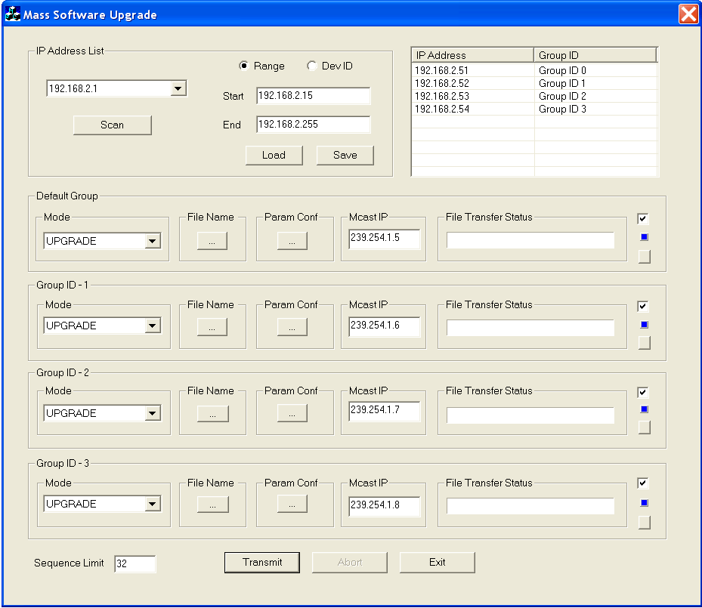
How easy to use MSU server
Ready for Upgrade process
  File selected
  Communication parameters selected
  Multicast IP address is assigned for each group (Automatic)
  Group Selected (Those are going to participate in current upgrade process)

Slide 14
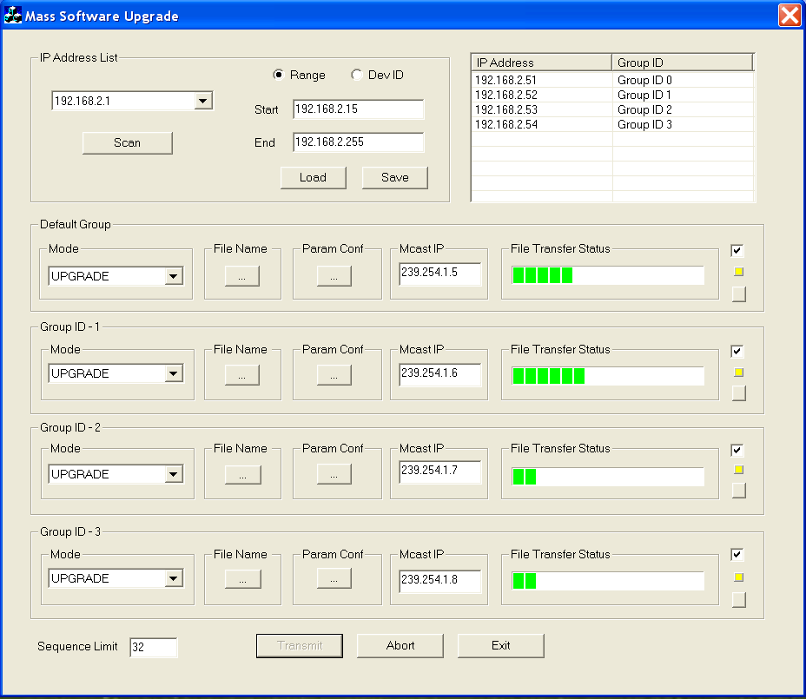
How easy to use MSU server
Start Upgrade process

Slide 15
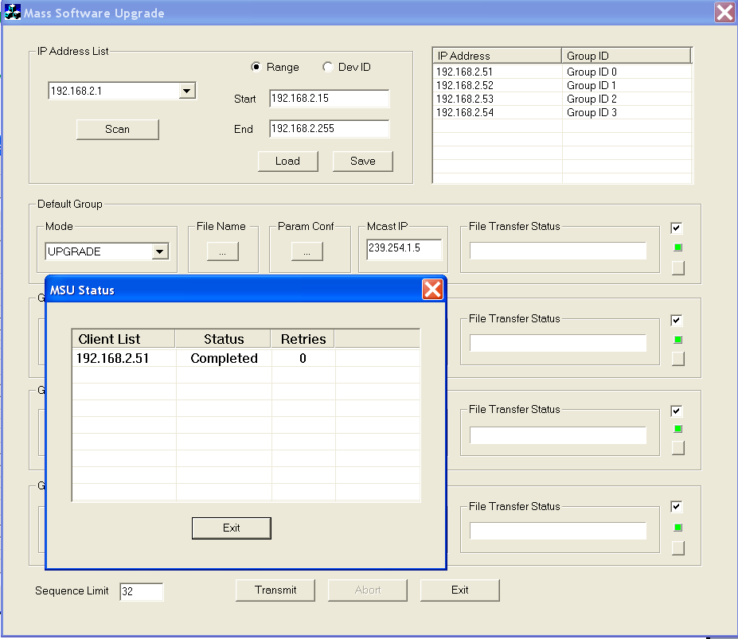
How easy to use MSU server
Finished Upgrade process
  Status of the devices

Slide 16
How easy to use MSU server
Finished Upgrade process
  Status of the devices

Slide 17
Where we Stand after OTM
Support massive (Common file for all device) only
One to one (each device need specific file) not supported can be expanded
Incremental changes not supported

Slide 18
Thank you for your kind attention !

